Slide 1
Gate II Approach
Gate II Is Intended to Validate That Your Proposed Business Operation Makes Financial Sense to Experienced CFO’s and Investors
Teams present 5-10 minutes of material, with time for 5 minutes of questions from the panel and 15 minutes of a working session.
All team members are present; mentors are encouraged to attend
CEO presents for 2-5 minutes, CFO presents for 3-5 minutes, then CFO discusses (and hands out) spreadsheets for discussion.
Presentations and hand-outs are responsive to the questions and items on the next page

Slide 2
Unit Economics: Building Blocks of Business Models
What do you sell?
Who are your target customers
What is a relevant unit?
Price and quantity – How to determine price
Customer acquisition cost
Lifetime value of customer

Slide 3







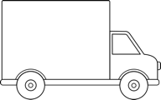
Example Business Model
Agricultural industry
Solid waste
$
Fertilizer
monthly
subscription fee
$
$
Waste Collection Service Companies
End user
+
use of
toilets
waste collection service
sale of toilets
10
Notes:
Change title to Business Model
Product and cash flow
reverse arrows showing money flow:
add truck
ok redo the visual of toilet

Slide 4
Example: How We Get There: Milestones
2015
2016
2017
2018
M1
M2
M3
M4
M5
M6
M7
M8
M9
M10
M11
M12
M1
M2
M3
M4
M5
M6
M7
M8
M9
M10
M11
M12
Initialize
Develop
Launch
Expand
Proof of Concept
Miniaturized Prototype
Beta Prototype
Marketable Product
Second Release
New Products
Product
Market
San Jose
Bay Area
5 Metro Areas
Asia / Europe
Company
Build Development Team
Begin Manufacturing
US Sales Force
Global Sales Force
Seed Round: $1MM
Notes:
4

Slide 5
Financial Projections
Millions
$70.9
Breakeven in 14 Months
Revenues
Net Cash Flow
Main Drivers | Year 1 | Year 2 | Year 3 | Year 4 | Year 5
# of Units Sold / Year | 2,000 | 4,200 | 6,800 | 10,200 | 14,280
Enterprise Customers | 1 | 6 | 18 | 48 | 122
Gross Margin | - | 41% | 63% | 72% | 74%
5

Slide 6
5-Year Summary P&L ($000s)
 | 2014A | 2015B | 2016P | 2017P | 2018P | 2019P
Total Revenue | $ - | $100 | $1,500 | $13,000 | $38,000 | $54,000
Cost of Sales | 0 | $ 100 | $ 1,000 | 4,000 | 11,000 | 15,000
Gross Profit | 0 | 0 | 500 | 9,000 | 27,000 | 39,000
Gross Margin % | 0% | 0% | 33% | 69% | 71% | 72%
General and Administration | 100 | 100 | 500 | 1,000 | 3,800 | 4,860
Research and Development | 300 | 800 | 1,400 | 3,500 | 6,840 | 8,100
Sales and Marketing | 100 | 300 | 500 | 3,000 | 9,880 | 11,340
Total Operating Expense | 500 | 1,200 | 2,400 | 7,500 | 20,520 | 24,300
Operating Income | (500) | (1,200) | (1,900) | 1,500 | 6,480 | 14,700
EBITDA | $ (500) | ($1,198) | ($1,857) | $1,600 | $6,680 | $15,100
Depreciation and Amort | 0 | 2 | 43 | 100 | 200 | 400
Other (Income)/Expense | 0 | 0 | 0 | 0 | 0 | 0
Interest (Income)/Expense | 0 | 0 | 0 | 0 | 0 | 0
Pre-Tax Income | ($500) | ($1,200) | ($1,900) | $1,500 | $6,480 | $14,700
Tax Expense (Benefit) | 0 | 0 | 0 | 0 | 1,226 | 4,116
Net Income | ($500) | ($1,200) | ($1,900) | $1,500 | $5,254 | $10,584
G&A % Revenue | NM | 100% | 33% | 8% | 10% | 9%
R&D % Revenue | NM | 800% | 93% | 27% | 18% | 15%
Sales & Marketing % Revenue | NM | 300% | 33% | 23% | 26% | 21%
OpEx % Revenue | NM | 1200% | 160% | 58% | 54% | 45%
NI % of Revenue | NM | NM | NM | 12% | 14% | 20%

Slide 7
Operating Stack - Example (OPEX)
Year 2013 2014 2015 2016 2017 2018 2019
Employees 11 18 24 32 43

Slide 8
Items for CFO – Handouts for Working Session
Income Statement
Annual for 5 years of projections
Monthly for first 12-24 months
Detailed revenue build-up, including drivers/metrics
COGS/BOM, if necessary
Headcount plan
OpEx summary (Operating Stack)
Statement of Cash Flows
Balance Sheet

Slide 9
Questions for CEO
Who are you, what do you do?
What do you sell – be specific?
What is the customers’ need for your product/service? Who needs you most?
What is your business model?
What aspects of your business model have you validated with field research and what still needs validating? How will you validate?
What amount of funding are you seeking, and what milestones will you achieve with that finding?

Slide 10
Questions for CFO
What is your revenue model?
What are the unit economics of your business?
What are the most significant financial assumptions for your business? What proxies or market validation do you have for these assumptions
How do your assumptions comparison of your economics to proxies
What are financial projections for your business?
What will be the use of funds for this funding round?

Slide 11

R&D Plan Process
Mike Lyons

Slide 12
R&D Plan Questions
What Is The Product? How Does The Technology Work?
Describe Architecture, Key Science, Development Risks
What Is Your IP Protection Approach?
Not Always Relevant
What Is Your Development Strategy/Process?
What Is Your Development Timeline/Release Schedule?
Driven by Regulatory Issues?
What Is Necessary Headcount to Achieve Release Dates?
What Is Your Manufacturing Strategy?
Contract Manufacturing (CM) or In-House?
Testing and QA
How Do You Price the Product? What Is Implication for the Business Model?
What Is Your Sales Channel Strategy and Cost
Reading: On the website: Appendix A: DEFINING A MANUFACTURING STRATEGY IN A START UP ENVIRONMENT, by Karen Meyer
Notes:
The team: Diverse experience with network layer expertise.

Slide 13

Tech Venture Product Build Strategy
Product Design Infrastructure Maturity
Lean Startup Domain
Takes $$+Time
Bad
Adoption Begins
High-Tech Initial Condition
Bad
Manufacturing and Deployment Infrastructure Maturity
See also: After Bohem et al.
©
Notes:
Univ and gov’t labs cannot play in the lean startup region

Slide 14
Top Ten Reasons Your R&D Plan Doesn’t Cut It
You Have No Plan to Protect Your IP (or You Didn’t Even Discuss It)
Your Technology Is Based On Warp Drive That You Have No Idea How to Build
Your Engineering Plan Is Not Tied to Any Credible Timeline/Milestones
You Started Shipping Your First Product 90 Days After You Got Funded
You Didn’t Discuss or Explain Your Manufacturing Strategy Such That Product Pricing Makes Sense and Costs to Develop and Test Are Reasonable
You Didn’t Define/Explain Your Sales Channel in Enough Detail to Understand Product Pricing
Your Engineering Headcount and Product Develop Expenses Decline After FCS
The Timing/Amount of Your Venture Rounds is Not Properly Triggered by Financeable Milestones Such as Product Releases
Your EBITDA (as % of Revenue) Is Way Too High for a High Growth Early Stage Product Company
You Built a $400M Revenue Stream in Year 5 with 10 People and No Sales and Marketing Expenses; Product Support Is Totally Ignored

Slide 15


Hardware Startup Concepts
Notes from Dr. DAVID CRAWLEY

Slide 16
Section 1
Product Development as a Learning Problem

Slide 17


Why Do These Inventions Not Exist?
Xeon EX-26XX 9GHz
An ultra high speed Micro-Processor?
Don’t know how to manufacture it?
A General Purpose Domestic Robot?
Don’t know how to design it?

Slide 18
Both Design and Manufacturing Need to be Known
Known Design
Architecture
You need to move to the top right corner before release
Unknown Design
Unknown Manufacturing
Known Manufacturing Architecture
Source: After Bohem et al.

Slide 19

Flappy Birds Case
Known Design
Architecture
Situation:
-Current video games too complicated
-Simpler game needed
Manufacturing:
-iOS and Android phones already exist
-No manufacturing knowledge gaps
Design:
-Well developed OS, SDK and engines already exist
-Design problem trivial
Unknown Design
Unknown Manufacturing
Known Manufacturing Architecture /
Established platform
Time to Develop:
~3 days

Slide 20

Smart Watch X
Situation:
-Micro-processors and displays get good enough to do a “smart” watch
-Angel backed team starts development
Notes:
A hundred years ago the automotive industry looked a lot like the semiconductor industry does now with many players who all sought to differentiate themselves on technology. Over time only those that embraced operational effectiveness survived. This type of consolidation is already happening in the semiconductor industry. For Cypress to be one of the survivors it will need to wholeheartedly embrace Lean Principles.
The timeline describes how this happened and how the key lean concepts of Level, Flow, Pace and Pull came about. In the 1890’s each car was made by an individual worker, one car one worker and this took months. This created a problem for Henry ford because when someone left it was tough to bring a new worker up to the required skill level. So he cut the task of building a car in to small standardized pieces of work 2.2 minutes long with many workers per car. This enabled him to bring new workers up quickly and level out the work – as it turns out not only could he bring new workers on but they were more efficient, we call this levelling. Ford didn’t stop there he created a moving production line, where the unfinished product would move from one worker to another without stopping, the effect was that efficiency improved still further as non-value added tasks were naturally eliminated, we call this flow. These innovations formed the basis of Mass production and allowed Ford to become the largest company in the world.
Toyota took these ideas and went further. Based on their experience in war production where they needed many units and didn’t have enough resources they tied all the processes in the factory exactly to the rate needed by the customer, something we call pace. In this way they didn’t waste any capacity or any resources as only what was needed was built. Taking ideas from US retail they created internal supermarkets in their factory where parts could be efficiently supplied with minimal inventory. This enabled them to supply the products that the customer wanted while minimizing inventory. A concept we call pull. As you can see lean is an integrated set of principles and practices that has enabled Toyota to become the largest car company in the world. It is not something that has just been applied to manufacturing. From the beginning lean was applied to a wide variety of functions including design, manufacturing, finance. Since the 1990s lean has been applied to a wide variety of industries and including banking, healthcare and semiconductors.

Slide 21

Smart Watch X
Known Design
Architecture
Step 1
Assemble team gather funding
Step 2
Design and market a smart watch with
-E-ink screen
-Curved touch screen
!
Step 3
-Try to get reliable supplier for E-ink screen
-Try to reliably manufacture curved touch screen
Unknown Design
Unknown Manufacturing
Known Manufacturing Architecture
Time to Develop:
~1.5 years still not released

Slide 22
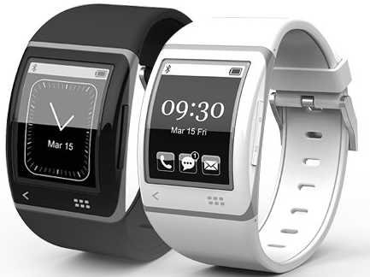
Smart Watch S
Situation:
-Micro-processors and displays get good enough to do a “smart” watch
-VC backed team starts development
-Decide to use
-E-ink screen
-Curved touch screen
-2 Years later and product not released

Slide 23
Smart Watch X
You don’t have a minimum viable product when you have a prototype. You have a minimum viable product when you have a prototype you can manufacture.

Slide 24
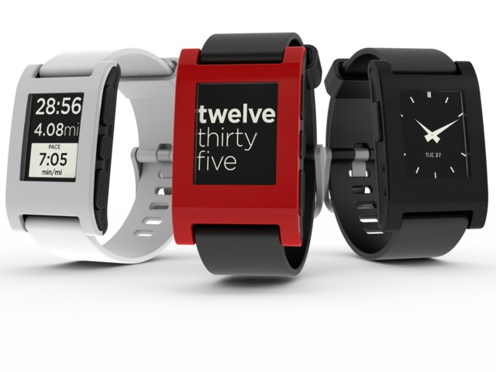
Smart Watch P – How to Do it right
Situation:
Micro-processors and E-Ink displays to pop notification from your phones to your wrist
Most successful Kickstarter launch in history

Slide 25

Smart Watch P
Known Design
Architecture
Step 1
Prototype product “inPulse”
1500 units
Assembled in US
Build for Blackberry
Step 2
Design and market a smart watch with
-Flat screen
-E-ink display
-For Android and iOS
Step 3
-Started manufacturing in China with limited oversea mfg experience
-Adhesive screen glue fails in mass production environment.
-CEO spent 1/3 of time flew to China to solve problems
!
Unknown Design
Unknown Manufacturing
Known Manufacturing Architecture
Time to Develop:
~1 year

Slide 26
Section 2
How to assess and work with suppliers

Slide 27
Working with contract manufacturers
Service Quality
(Mfg Quality, Reliable Sourcing Network, On-Time Delivery, etc.)
Top Tier CM (e.g. Honghai, Flextronics) Requires
High commitment of capital
High incoming quality requirement
Complex business process to setup
Potential schedule de-prioritization
Expensive component quotation
Don’t do it unless you can deal with rigorous design requirements
Second Tier CM
(e.g. sumitronics, beyonics)
Small Sized CM Provides
Low barrier for capital commitment
Flexible in incoming quality requirement
Easy to setup
Schedule support
Don’t do it until you can independently guarantee quality
Capital Commitment
(Initial Volume, Tooling Cost, Component Quotation, etc.)
Source: Interviews with HW Startups and VCs

Slide 28


Sunpower
Situation:
-Advances in semiconductor technology and high energy costs lead to the possibility that solar will be less expensive than grid power within a generation.
Notes:
A hundred years ago the automotive industry looked a lot like the semiconductor industry does now with many players who all sought to differentiate themselves on technology. Over time only those that embraced operational effectiveness survived. This type of consolidation is already happening in the semiconductor industry. For Cypress to be one of the survivors it will need to wholeheartedly embrace Lean Principles.
The timeline describes how this happened and how the key lean concepts of Level, Flow, Pace and Pull came about. In the 1890’s each car was made by an individual worker, one car one worker and this took months. This created a problem for Henry ford because when someone left it was tough to bring a new worker up to the required skill level. So he cut the task of building a car in to small standardized pieces of work 2.2 minutes long with many workers per car. This enabled him to bring new workers up quickly and level out the work – as it turns out not only could he bring new workers on but they were more efficient, we call this levelling. Ford didn’t stop there he created a moving production line, where the unfinished product would move from one worker to another without stopping, the effect was that efficiency improved still further as non-value added tasks were naturally eliminated, we call this flow. These innovations formed the basis of Mass production and allowed Ford to become the largest company in the world.
Toyota took these ideas and went further. Based on their experience in war production where they needed many units and didn’t have enough resources they tied all the processes in the factory exactly to the rate needed by the customer, something we call pace. In this way they didn’t waste any capacity or any resources as only what was needed was built. Taking ideas from US retail they created internal supermarkets in their factory where parts could be efficiently supplied with minimal inventory. This enabled them to supply the products that the customer wanted while minimizing inventory. A concept we call pull. As you can see lean is an integrated set of principles and practices that has enabled Toyota to become the largest car company in the world. It is not something that has just been applied to manufacturing. From the beginning lean was applied to a wide variety of functions including design, manufacturing, finance. Since the 1990s lean has been applied to a wide variety of industries and including banking, healthcare and semiconductors.

Slide 29
Sunpower
1985: Sunpower incorporated
Known Design
Architecture
1990s: Developed designs based on variations of known silicon technology
2002: Sunpower acquired / funded by Cypress Semiconductor. Cypress adds senior manufacturing executives to team
2004: Opens large scale pilot (Fab 1)
2007: Opens large full scale plant
2008: Announces 23.4% efficiency design
!
Unknown Design
Unknown Manufacturing
Known Manufacturing Architecture
2008: Company IPO / Spin out
“Silicon is the second most studied material system in the world after concrete”, Cypress CEO T.J. Rogers

Slide 30


Nano-solar
Situation:
-Advances in semiconductor technology and high energy costs lead to the possibility that solar will be less expensive than grid power within a generation.
Notes:
A hundred years ago the automotive industry looked a lot like the semiconductor industry does now with many players who all sought to differentiate themselves on technology. Over time only those that embraced operational effectiveness survived. This type of consolidation is already happening in the semiconductor industry. For Cypress to be one of the survivors it will need to wholeheartedly embrace Lean Principles.
The timeline describes how this happened and how the key lean concepts of Level, Flow, Pace and Pull came about. In the 1890’s each car was made by an individual worker, one car one worker and this took months. This created a problem for Henry ford because when someone left it was tough to bring a new worker up to the required skill level. So he cut the task of building a car in to small standardized pieces of work 2.2 minutes long with many workers per car. This enabled him to bring new workers up quickly and level out the work – as it turns out not only could he bring new workers on but they were more efficient, we call this levelling. Ford didn’t stop there he created a moving production line, where the unfinished product would move from one worker to another without stopping, the effect was that efficiency improved still further as non-value added tasks were naturally eliminated, we call this flow. These innovations formed the basis of Mass production and allowed Ford to become the largest company in the world.
Toyota took these ideas and went further. Based on their experience in war production where they needed many units and didn’t have enough resources they tied all the processes in the factory exactly to the rate needed by the customer, something we call pace. In this way they didn’t waste any capacity or any resources as only what was needed was built. Taking ideas from US retail they created internal supermarkets in their factory where parts could be efficiently supplied with minimal inventory. This enabled them to supply the products that the customer wanted while minimizing inventory. A concept we call pull. As you can see lean is an integrated set of principles and practices that has enabled Toyota to become the largest car company in the world. It is not something that has just been applied to manufacturing. From the beginning lean was applied to a wide variety of functions including design, manufacturing, finance. Since the 1990s lean has been applied to a wide variety of industries and including banking, healthcare and semiconductors.

Slide 31
Nano-solar
Known Design
Architecture
Company Failure
2002: Company funded decided to pursue Organic semiconductor “paint on” solar cells
2002: Started development of a CIGS suspension “paint on” solar cells
2006: Created a working CIGS solar cell
2006: Attempt to develop manufacturing facility
!
2011: Company Failure
Unknown Design
Unknown Manufacturing
Known Manufacturing Architecture

Slide 32
How to work with CMs
Higher commitment for working capital
Bottom Tier
(e.g. Thousands unknown
workshops in Shenzhen)
Schedule de-prioritization
Flexible in schedule
Challenges of incoming quality requirement
Challenges of incoming quality requirement
Complex process setup prior to production
Complex process setup prior to production
Top Tier
(e.g. Foxconn)
High quality product
Reliable component sourcing network
Reliable components sourcing network
Reliable component sourcing network

Slide 33
Bio-Design Example
Following Slides Illustrate a Class Project for Breast Cancer Detection
Product Development Must Include Regulatory Elements
Timelines Tied Out to Financing Requirements

Slide 34
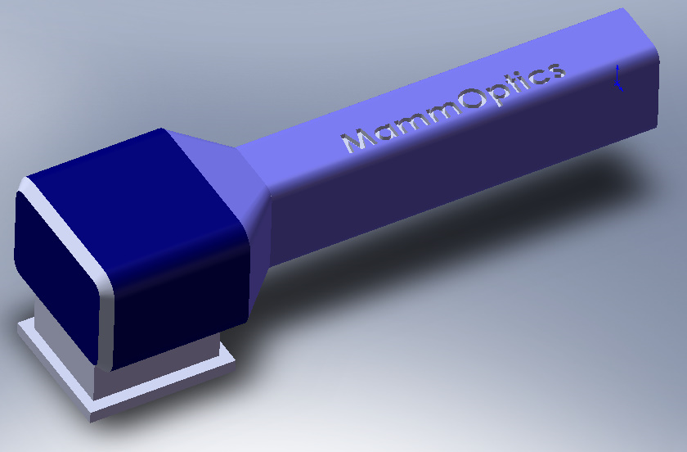

The MammOptics Technology
Hand-held, self contained device
Digital Processing Unit
RF and Advanced
Integrated Circuit
Probe (Lasers
and Photo-detectors)
Disposable Skin Contact Head
Non-Imaging Output
9 Inches
~5 lbs

Slide 35


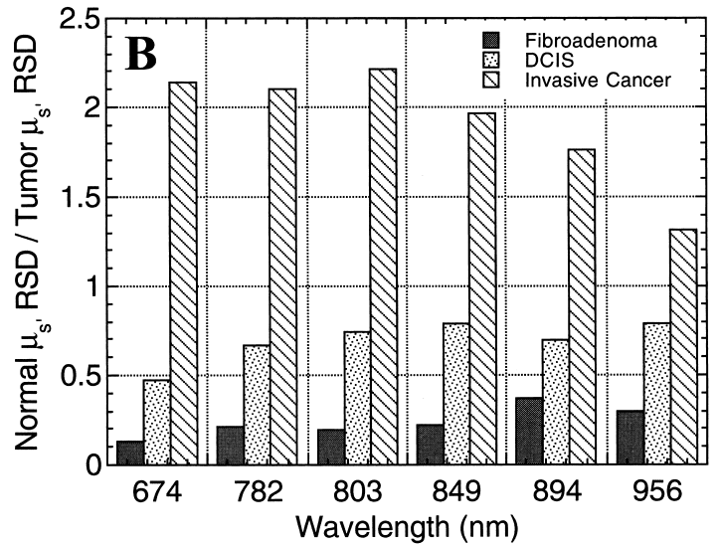
How it Works
Operates like a Radar system
Abnormality detected!
d = 1cm
d
Direction of probe
Different physiological content

Slide 36

System Design and IP Protection
Digital Processing Unit (DSP)
RF and Electronic Advanced Integrated Circuit (IC)
Independent Patent
FDPM Technology Exclusive Licensing
FTO Plan
Control
Two Decision Variables
Independent Patent
RF Result
Bank of Lasers
RF Signal
Dependent IP on System Design
Dependent Application
IP for
Early Stage Breast Cancer Detection
Photo-detector
Independent Patent on Disposable Pad
Tissue

Slide 37
Technology Comparison
Method | Risk | Invasiveness | Resolution | False pos. | False neg. | Cost | Time
MammOptics | + | + | + | +/- | + | + | +/-
Mammography (Screening) | - | - | +/- | +/- | +/- | +/- | +
MRI | +/- | +/- | + | - | + | - | -
Ultra-Sound | + | + | - | - | - | + | +/-

Slide 38
Clinical Trial Stages
Stage 1
Pilot Trials
Performed Outside US
50 patients
Total cost: $1.7M
Focus on feasibility / comparisons to Mammography
12 Months
Quarters
3-6

Slide 39
Clinical Trial Stages
Performed in Europe
200 patients
Total cost: $5M
Stage 2
CE Mark Trials
Focus on statistical non-inferiority clinical results
Path can be compared to proxy (Genomic)
12 Months
15 Months
Quarters
3-6
Quarters
8-12

Slide 40
Clinical Trial Stages
Performed in the US
500 patients
Total Cost: $14.5M
Focus on non-inferiority
FDA class II, 510(k) with clinical
Non-specific APC codes and Cat. III CPT for trials and initial launch
Stage 3
Pivotal Trials for FDA
12 Months
15 Months
18 Months
Quarters
3-6
Quarters
8-12
Quarters
13-18

Slide 41
Clinical Trial Stages
Stage 4
Post Market Studies for Specific Codes
Publications, etc. for APC / CPT Codes Acquisition
Performed in the US
1000 patients
Total cost: $24.5M
Focus on superiority clinical results / market traction
12 Months
15 Months
18 Months
Quarters
3-6
Quarters
8-12
Quarters
13-18
Quarters
19-28

Slide 42
Financial Assumptions
CPT Code Finalized
Gain support of private insurance
Greater market traction
Market adoption rate modeled after Cytyc’s ThinPrep
Similar demographic, procedure count
Steady growth of procedure count
Begin at 2,500/device
Priced for 75% gross margin
ThinPrep 78% gross margin
Typical in medtech industries
4,000/device average mammograms

Slide 43
How We Get There: Milestones
2010
2011
2012
2013
2014
2015
2016
Q1
Q2
Q3
Q4
Q1
Q2
Q3
Q4
Q1
Q2
Q3
Q4
Q1
Q2
Q3
Q4
Q1
Q2
Q3
Q4
Q1
Q2
Q3
Q4
Q1
Q2
Q3
Initialize
System
Regulatory / Clinical
Launch
Proof of Concept
Miniaturized Prototype
Beta Prototype
Marketable Product
Second Release
Design/Test
“This is a well-tailored opportunity for the hot breast cancer diagnostics industry. I see promising plans here.”
Paul Yock, MD/PhD, Director of Stanford BioDesign Program
Lab. Prototype
Miniaturized Testing
Beta-Ver. Testing
1st Release Test
2nd Release Test
Publication
Clinical
Pilot Studies
Europe Clinical Trials
US Pivotal Clinical Trials
Clinical Results
Post-Market Clinical Studies
CE Mark -Class IIa
Non-Specific Codes
Regulatory
IRB / IDE
Cat. III CPT
FDA – Class II – 510 (k) with Clinical Trials
Specific Codes
(Cat. I CPT)
Provisional Patent
Application and System Patents
IC and Processing Patents
Disposable Part Patent
Initial Product Launch
IP
Technology Licensing
Notes:
43

Slide 44
What we need to get there: Fund Raising
2010
2011
2012
2013
2014
2015
2016
Q1
Q2
Q3
Q4
Q1
Q2
Q3
Q4
Q1
Q2
Q3
Q4
Q1
Q2
Q3
Q4
Q1
Q2
Q3
Q4
Q1
Q2
Q3
Q4
Q1
Q2
Q3
$40M
Series D $35 MM
Series E $40 MM
$30M
$20M
Series C $22 MM
Cash Reserve
Series B $10 MM
$15M
$10M
Series A $3.5 MM
$5M
Initialize
System
Regulatory / Clinical
Launch
Proof of Concept
Proof of Concept
Miniaturized Prototype
Miniaturized Prototype
Miniaturized Prototype
Beta Prototype
Beta Prototype
Beta Prototype
Marketable Product
Marketable Product
Second Release
Second Release
Design Milestones
Laboratory Prototype
Laboratory Prototype
Laboratory Prototype
Miniaturized Testing
Miniaturized Testing
1st Release Test
1st Release Test
2nd Release Test
Beta-Version Testing
2nd Release Test
Beta-Version Testing
Publication
Publication
Post-Market Clinical Studies
Clinical Results
Post-Market Clinical Studies
Europe an Trials
Clinical Results
Europe an Trials
US Pivotal Clinical Trials
US Pivotal Clinical Trials
Pilot Studies
Europe an Trials
US Pivotal Clinical Trials
Pilot Studies
Clinical Milestones
Pilot Studies
CE Mark -Class IIa
CE Mark -Class IIa
Non-Specific Codes
CE Mark -Class IIa
Non-Specific Codes
IRB / IDE
IRB / IDE
Cat III CPT
Cat III CPT
Specific Codes
(Cat. I CPT / APC)
FDA – Class II – 510 (k) with Clinical Trials
Specific Codes
(Cat. I CPT / APC)
FDA – Class II – 510 (k) with Clinical Trials
FDA – Class II – 510 (k) with Clinical Trials
Provisional Patent
Provisional Patent
Regulatory/ IP Milestones
Application and System Patents
Application and System Patents
Initial Product Launch
IC and Processing Patents
Initial Product Launch
IC and Processing Patents
Disposable Part Patent
Disposable Part Patent
Technology Licensing
Technology Licensing
Technology Licensing
Notes:
44

Slide 45
Customer NPI Phases
Alpha
Release of product for internal use.
Beta
Release of the product for customer trial.
First Customer Shipment (FCS)
The first shipment of product to a customer for revenue…”controlled production release”.
General Availability (GA)
Product is fully released for shipment of unlimited quantities to all customers.
Notes:
The team: Diverse experience with network layer expertise.

Slide 46
Handspring Timeline

Slide 47
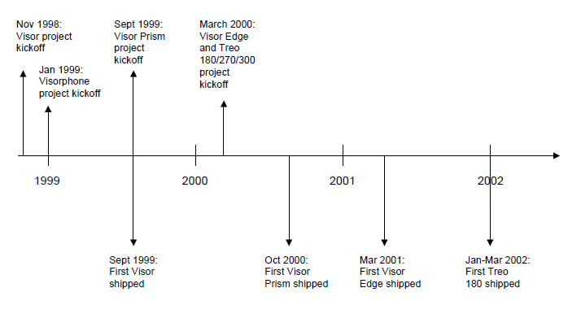
HandSpring Timeline

Slide 48
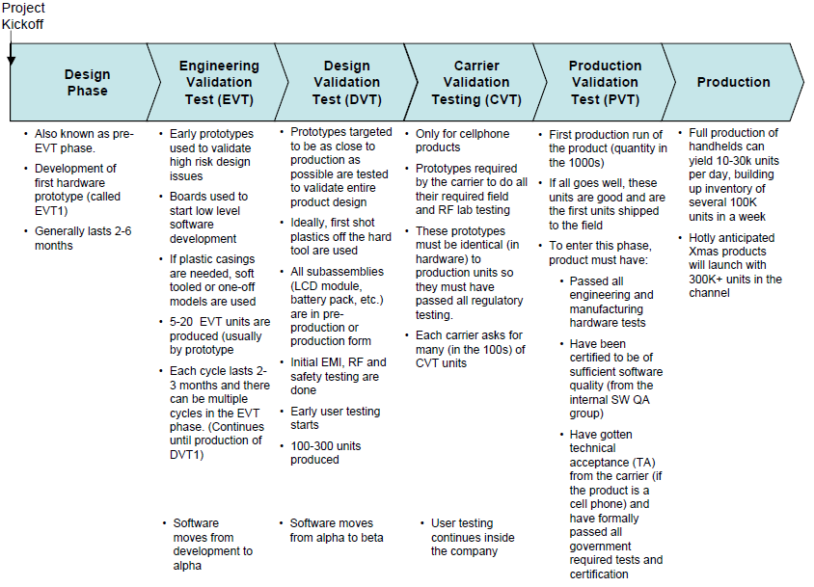

Slide 49
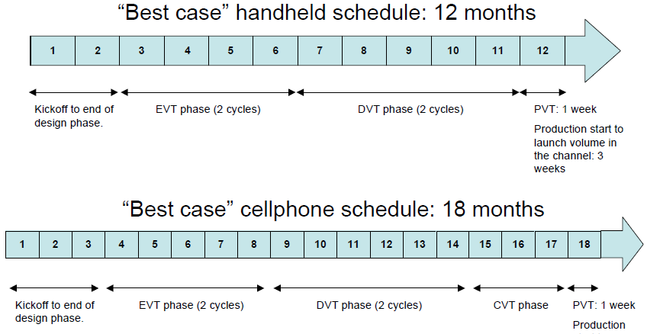
HandSpring Timeline

Slide 50
Handspring Operations

Slide 51
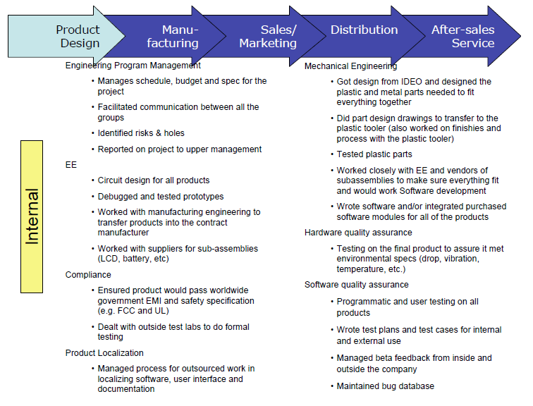

Slide 52
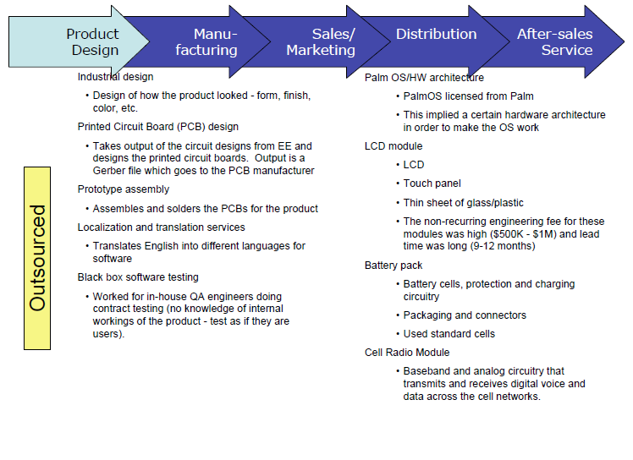

Slide 53
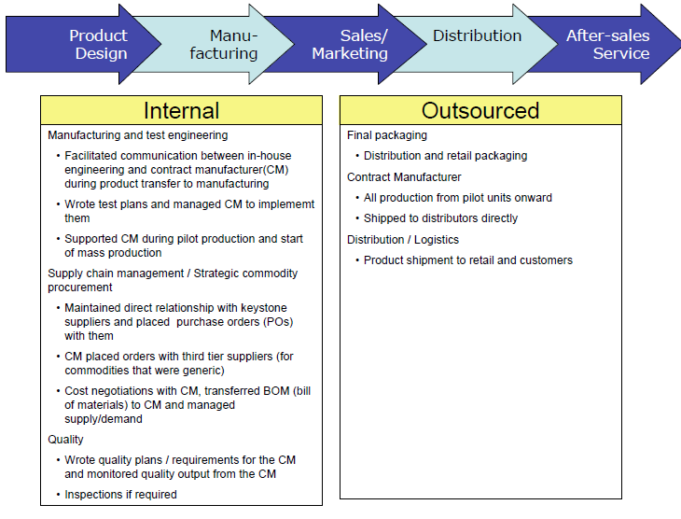

Slide 54
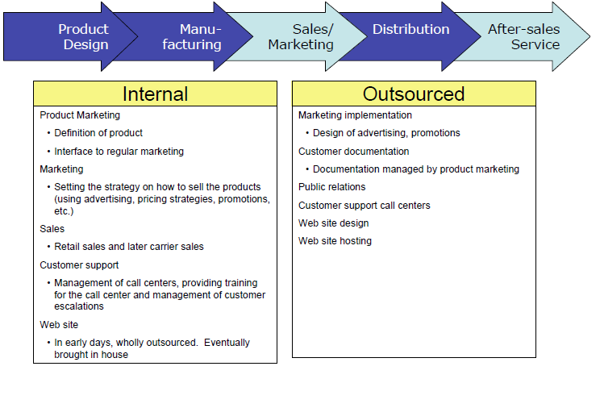

Slide 55
Creating Enterprise Software Products in Startups
Creating Enterprise Software Products in Startups

Slide 56
Sizing Teams Developer/SQA count & R&D time
Consumer product: (from developer start to product GA)
1 SWE, 2 months: Internet sharing product
6 SWEs,~ 7 months: personal firewall product
100+ SWE: large security software in a large company
Enterprise product
12 SWEs, ~10 months: managed host-based firewall for enterprise
30 SWEs, ~14 months, large enterprise security solution (plus ~4 in offshore R&D office), around 80% new code

Slide 57
Team Expectations
VP of Engineering
Never Did It Before but Highly Skilled
CEO
Needs to understand R&D, which consumes most of budget in early stage
Synergy and Communication with Engineering VP
Engineers interested in Startup
Will Join Because Excited by Startup Environment
Big Company Work Style May Not Work

Slide 58
Startup Challenges
Unproven market or unproven technology
Or both
Narrow time window
Yes we made it, but it is too late
Competitors Get There First
No credibility with Customers
“No one gets fired for buying IBM”
BigCo Can Use v3.0 Rule
Startup Has to Get v1.0 Right!
Best When No Big Competitors in Your Space
Getting Early Reference Customers Is Key
New, unproven team
Everyone has strengths and weaknesses
Effective Execution/Management Is Key
Drip Financing
Trickle Seed Funding Will Challenge Development Momentum
Usually Results in Missing the Market Window

Slide 59
Enterprise product
Existing Enterprise Environment is Large; Hard to Change It
More changes Reduce Adoption Rate/Chance to Sell
Graceful Adoption is Key; Throw Out and Start Over is a NO OP
Large Supplemental Feature Set Required
High availability, no single failure point
Distributed deployment
Disaster recovery, backup and Restoration
Active Directory/LDAP (Lightweight Directory Access Protocol) integration
Fully customizable, each company is different
Always able to “turn it off”
Security patch and update
Large scale User Base
10,000 is minimal
50,000 is normal
200,000 is not uncommon

Slide 60
Enterprise Product – cont.
Mission Critical
Graceful Failure v. Disaster
User Errors Create Disasters; e.g. Don’t Get Locked Out
Security requirement and compliance; Use Standards
Don’t invent home-made authentication/encryption methods unless it is your product’s main feature.
One shot only
“I promise you it will work this time.” “ok, let’s try one more time”
“I promise you it will work this time.” “ok, let’s try one more time”
“I promise you it will work this time.” , no answer, guess what?
Busy admin and “dumb” user
Each support call costs money, not just helpdesk
Too many calls trash the product; Productivity Not Realized

Slide 61
Do Things That Matter (Focus!)
Understand the Market Opportunity
Understand VC’s Needs
Pick features that matter, for each stage of your company
What features make you so different?
What features are required for your first deployment?
What features are required for competitive advantage?
What features are required to create an exit (Valuation)?
These Questions are Usually Answered in Product Management (Could be CEO, CMO, or CTO early stage)

Slide 62
Chose The Right Tool and Technology
Goal: solve your problem at lowest cost in shortest time.
With some sort of flexibility for future expansion.
No magic, don’t fall in love with tool (PHP, Python, C⁺⁺, Open GL, etc.)
Considerations:
Don’t be the first user, or the last
Easy to find “a lot” of qualified engineers
Easy to test and troubleshoot
Easy to learn
Be careful with Open Source
License: GPL/LGPL*/Apache/BSD/MIT/MS-PL/CPOL
Who is behind it
Who is using it, what’s the “Buzz”
Potential Big Problem at Exit
Religious war
Listen, then make your own choice; Assume It is Your Money
If you really don’t understand, delegate one with best knowledge, trust his/her choice and be result driven
*Potentially Dangerous

Slide 63
Find Great Engineers
Strong technical skill (for your approach)
Great experience, strong industry background
Smart
Innovative
Great work quality and quantity
Good communication skill
Team player
Work Ethic
Getting the Right Balance is Key

Slide 64
… At a good price
Find “right” one, not “great” one
Perfect SWE is very hard to find
Time is your enemy
Perfect SWE is expensive
You will likely lose the bid
You Will have to compromise
Be Alert to getting very productive/innovative engineers; 10x better than average; could save the company

Slide 65
What Can Be Compromised
Enterprise Experience
Need at least one or two engineers with enterprise experience , Not All
Only PM with enterprise experience is NOT enough
Smartness
Lots of routine work, simpler than you thought. Deploy key talent tactically
Innovation
Most folks don’t innovate at daily work. CTO/architects can be alternative.
Language Skills
Most time engineers write code, don’t talk in front of customers
Email reduces the need in many use cases.
Team Player
Can Be Taught on the Job

Slide 66
Be Careful on These
Dis-Honest Assessment on Progress
costs you a lot of money to detect/fix
Weak logical thinking
creates huge number of bugs
wastes you a lot of time on communication – “I still don’t get it”
Usually Discovered in Interview Process
Slow fish
Hard to survive in startup’s fast-paced environment
<1 yr full time programming experience
Intern is different story
Don’t work at full time
Software development needs focus and takes a while to “warm up” to be productive.
Note: talk to candidate’s cohort, References

Slide 67
Engineering Skill Level Structure (Ratios)
Depends on Specific Project
Assume level 1 to 5, 5 is the most senior level
Examples (L1/L2 : L3/L4 : L5)
1:1:1 if you have lots to research or CTO/VP ENG is not strong in technical details
2:2:1 balanced
5:2:1 money-saver
9:0:0 you better work 24 hours a day! (See offshore comments, works for consumer products with no release schedule)

Slide 68
Manager’s Role
You need one experienced manager
Not just for management work, also he/she is more mature when dealing with enterprise matters
CTO or VP of ENG can do it if they have the skill
Or learn and DIY, but it could be painful and hurts company
If you know how, home-grow rest of managers as team grows
It is easier to learn management skill than technical skill
knows product and team member much better and work more efficiently
Chain of promotion, one L5 to mgr, one L4 fills L5’s spot, one L3 fills L4’s spot, etc, motivates more engineers on similar budget
If you don’t, hire a manager from outside
Hire a good one and most likely one is enough
Let him/her hire or home grow rest of managers

Slide 69
Start to hire
Recruiting
Screen resumes yourself if possible
You (the manager) are the best recruiter; no misinterpretation of needs
If you don’t have a good manager, read previous slide
It saves tons of money and time
Interview
Calm down interviewee first
Knowledge != skill
Write small piece of simple code or test case
It tells you a lot
Don’t be greedy by using too complicated logic
It is not IQ test
You are hiring an engineer; not interviewing for MENSA

Slide 70
Work Environment
Cubical vs. Pod
Provide Productivity Tools
At least two monitors per engineer
Comfortable keyboard and mouse
Lunch time
Kitchen and Microwave
Short Lunch commute
High speed Internet
Whole World Wait costs your lots of money
HVAC hours

Slide 71
Operation and Procedure
Generalist vs. specialist
Get people focused, then it can be responsible
Rotate assignment every one or two releases, don’t burn out your engineers
You do need a few procedures in writing
Good process makes bad become good
Bad process makes good become bad
Maintain team
Understand your engineer’s need
Understand your engineer’s concern
Be ready for “I quit”
Every technology should be known by at least two engineers: one primary, one backup

Slide 72
Team Culture
We have 50 rules
Just kidding…
Each team has its own dynamics, but this one is good:
Encourage risk-taking for worthy benefits, but manager should monitor and manage the risk. For example, do risky work first
If they disagree, skip above
good manager/team will automatically form a certain culture that fits best to their daily work
Be results driven

Slide 73
Offshore R&D
Save lots of money, however:
Culture difference
Mostly junior engineers
High turnover rate in emerging country
Communication Only 1:1
Don’t Believe in Equity; must be Coin-Operated
Work mode
U.S. / offshore hybrid
Deal with conflict of Interest
Offshore only
Be careful, enterprise needs 24x7 support
Design special procedures
Cure the time-zone difference
Reduce high turnover rate impact

Slide 74
Using An Outsourced Force
For critical work
you better know the leader and can fully trust his skill and working style.
For non-critical work
Go ahead
Use short iteration cycles
chance to see result quicker and correct it if needed
Verify it with your team or another outsourced force

Slide 75
Sizing Teams, cont.
12 SWEs can do an enterprise product.
30 SWEs can do something very big.
To support prior version, add 2 to 4 SWEs.
Dev:QA can be 1:1 to 2:1.
could be risky when QA count is less 50% of developers.
To support prior version, add 2 QAs.
1 or 2 technical writers
1 program/project manager (optional)

Slide 76
Offshore Comparables
Offshore Salary:
It varies and changes frequently. In a major China city, SWE salary is about 10% (for L1) to 50% (for L4) of US’.
More senior the SWE is, the smaller the salary gap
Extra headcount in order to compromise high turnover rate
Enlarge team size by 50% to 100%
Map offshore engineer skills level to US’s engineer skill level: use China as example
US’s intern = L1 in china
US L1 = L2 in china
US L2 = L3 in china
US L3 = L4 in china
US L4 = L5 in china (hard to find)
US L5 = very hard to find

Slide 77
Creating Mobile & Web App Products in Startups
Creating Mobile & Web App Products in Startups

Slide 78
Waterfall vs Agile
Four main phases
Analysis
Design
Development
Testing
These exist in both Waterfall and Agile

Slide 79
Waterfall
Do each phase once
When a phase is done, go to the next, never looking back
Predictable: you know what you're getting
But what happens if requirements change during development?
Start over
This is costly

Slide 80
Agile
Composed of “sprints” (2-6 weeks)
Each sprint consists of all phases
Release early, release often
Get feedback from the customer
Doesn't matter how incomplete the software is
Adaptable: if requirements change, add new design requirements to the next sprint

Slide 81
Scoping a team
Figuring out what is needed
Determining how to allocate resources
Can you deal with developers being pulled by other projects?
Let’s Do An Example

Slide 82
Mobile App
Completely original “Friends with Words” app
Rules somehow similar to “Scrabble”
What is required to get a 1.0 version of this app off the ground within 6 months?
Notes:
Words with Friends Exists; scrabble on your phone

Slide 83
Evaluating Developers
Waterfall
Hard to know how quickly developers write code if you have to wait till the product is done
Agile
Every 2-6 weeks a snapshot of each developer's progress is possible
Lots of slow developers? Add another
Lots of fast developers? Rejoice
Notes:
Fast staff adjustments

Slide 84
Define the requirements
Graphics
Mobile Programming
Android
iOS
Others?
Server programming
Database
Quality assurance

Slide 85
Graphics
Should be done early
Resolution of phone vs tablet
Programmers need something to work with
Single artist
Relatively simple application
Can be contracted
But make sure source (e.g. SVG) is provided
Will Need Revisions, Perhaps from Another Vendor
Notes:
Sizing to place things on screen/game board here, not much space; scallng original is important to mod later

Slide 86
Mobile programming
Devices have different requirements
Android tends to be Java
iOS tends to be Objective C
Developer requirements depend on experience
In-house developers who have no mobile experience?
In-house developers who do have mobile experience?
New hires?

Slide 87
Mobile programming
In-house developers don’t know Mobile?
One learns Android (30 day Learning Curve)
One learns iOS
Dedicate a third to the backend
Tools like J2ObjC allow one language to be used on both devices
In-house with experience, or outside hires
One per device
Notes:
Learning takes a month to learn;UI stuff needs to be converted to other platform

Slide 88
Server programming
Development Platform
Scalability: how many users will there be?
What language?
C⁺⁺ Often Used (Takes Longer, More Errors)
JAVA Has Bigger Developer Pool; Middle Ground Choice
Erlang/Scala More Scalable; Few Developers
Key Requirements
Coordinate play between numerous pairs of users
Know and enforce game rules (no device hacking)
Allow chatting between users
Notes:
Language C++ often used; takes longer, more errors; JAVA more developers but safer takes a while. Erlang or Scala more scalable; back end knows rules because Devices will be hacked

Slide 89
Scalability
Difficult task
Brute Force with More Hardware?
Write with scalability in mind from day one
Language choice plays a role
Database is also very important
MySQL or PostGreSQL
Usernames and passwords
Scores
Friends
If the database disappears, the product disappears
Notes:
Database like MYSQL; PostGreSQL

Slide 90
Languages
The main question: in-house developers or new developers?
For in-house developers in an established company, no real choice but what they know
Java, C++
If hiring new (e.g. a startup), perhaps be bold and choose a less-popular, more scalable language
Erlang, Scala
But...

Slide 91
Developers, developers, developers
Java
Throw a stone and hit four Java developers
C++
Throw a stone and hit one C++ developer
Scala
Throw a stone and hit a Java developer who has heard of Scala
Erlang
Throw a stone into a quarry and an Erlang developer might hear it

Slide 92
The pragmatic choice
Hiring a new Java or C++ developer is easy
Hiring a new Erlang or Scala developer is hard
What if a team member quits or must be let go?
Is a language which allows faster development worth it if you can’t find a new developer?
Prefer a safer, slower to develop language?

Slide 93
Assigning the work
If I’m gathering developers, I might start:
Erlang/Scala: two developers
Java: three developers
C++: four developers
Fewer is possible if necessary to get in under budget
But make sure the work can get done
Long hours are possible but not sustainable
Very rough estimate: use Agile to adjust as necessary;2 months beta;6 Months Notional Time (Fully tested and trialed)

Slide 94
Database Administrator/DBA
The ideal situation is to use a dedicated database administrator
DBA’s can create optimized database structures
DBA’s can create redundant, fault-tolerant DB setups
DBA’s can be expensive
Startups will likely have a developer masquerade as a DBA

Slide 95
Quality Assurance
Continuous integration
At all times, the entire product should be testable
Unacceptable to be broken for weeks at a time
Spike with minimal implementations
A complete, minimal implementation is more testable than a feature-complete tiny part of the system
Build systems
All versions of the product should build at the push of a button

Slide 96
Testers
Developers are terrible testers
Too close to be able to see what’s wrong
Dedicated testers
Ideally a dedicated app tester, dedicated server tester, and dedicated security tester
Integrate testers with the development process
Test while developing, not after

Slide 97
Team breakdown
Graphics developer: 1
Mobile developers: 2 or 3
Server developers: 2, 3, 4
Depends on language
Database admin: 1
Testers: 3
Can get away with fewer, but be careful
Build system/continuous integration: 1
This is a luxury position

Slide 98
Web app
Another original idea: “social media” site where users share photos

Slide 99
Define the requirements
HTML/Web content
Web programming
Server programming
Database
Quality assurance

Slide 100
Web content
Similar to game graphics, but more involved
Experienced HTML/CSS developer needed
Consistent appearance across whole site
Must be tested with major browsers, including mobile browsers
Can be contracted, but will require more back-and-forth with developers and product owners
If possible, do in-house

Slide 101
Web programming
Handle issues such as messaging between users, uploading photos, etc.
Acts as glue between the web interface and server backend

Slide 102
Frameworks
Many frameworks from which to choose
Rails
ChicagoBoss
Grails
Lift
Mason
...

Slide 103
Which to use
The choice of framework is not hugely important
Important insofar as you need to find developers for it
Some frameworks are built on slower languages
Rails is popular, Ruby is slow
Start with two developers, adapt as necessary
Notes:
Language runs slowly as opposed to JAVA; IO bound waiting for network tfc. Not necess. important

Slide 104
Optimization
Slow framework: does it matter?
Web server itself is a big choice
Load-balancing
More servers an acceptable solution?
At some point it’s the only solution
Caching
If content doesn’t need to be generated, don’t generate it
Dedicate a member to infrastructure if possible
Notes:
Cache static pages

Slide 105
Server programming
Very similar to the mobile app
Clients are not mobile users, but instead the web backend
Still must scale
Dealing with many web users is analogous to dealing with many mobile users

Slide 106
Quality assurance
Same vein as mobile
Testers
Site is always available in staging area
User-facing website is always tested
Absolutely no pushing out untested changes, no matter how simple

Slide 107
Testers
Site tester
Make sure all aspects of the web site work according to design
Server tester
Make sure the server responds to all expected requests, and does so in a timely fashion
Optimization
Always keep testers in the loop!

Slide 108
Team breakdown
Web content: 1
Web developers: 1 or 2
Web infrastructure: 1
Server developers: 2, 3, 4
Depends on language
Database admin: 1
Testers: 3
Build system/continuous integration: 1
Notes:
Add features in subsequent sprints over 6 months

Slide 109
Understaffed?
Adding developers is easy
Relatively speaking
Watch out for the mythical man month
Adding developers to a late project makes it even later (Brooks’ Law)
However, if a new feature is self-contained (or close to it), a new developer need not be brought up to speed on the entire project to work on it

Slide 110
Let’s Innovate

Slide 111
Product Development in a SaaS Startup
MSE 273
October 21st, 2014

Slide 112
Background
Product Dev: Team and Process
Lessons Learned

Slide 113
Granular History
MSE 273
“Agralytics”
Solum Series B
+a16z, +GV
Granular Launched
2008
2009
2012
2013
2014
Solum Series A
Khosla Ventures
Lab and Meas.
Sold to MON

Slide 114
Granular Overview
Mission
Granular is building a business management platform for professional farms…(think Oracle or SAP custom-built for farmers)
Company
Team: ~25 in SF, additional remote team
Investors: Andreeson-Horowitz, Google Ventures, Khosla Ventures
Industry/Customers
Small to Medium Businesses (SMBs)
$5-$100M/year rev
Nascent software market: FMS is a new category

Slide 115
Special Challenges for Granular
- Domain specific knowledge: agriculture
- Physically removed from the customer
- Annual operations schedule

Slide 116
What we’ve done…
Start writing code
Start beta testing
Official launch
09/13
04/14
08/14

Slide 117
Product Dev. Process
Requirements
Design
Implementation
Waterfall
VS.
Learn
Build
Measure
Agile

Slide 118
Product Dev. Team
Product Management:
What do we build? What is valuable?
Design:
How does it work? Is it usable?
Engineering:
Can we build it? Is it feasible?
Design
Eng.
P.M.
Notes:
Fleet Capacity Planning – Figure of ways to forward predict capability to take on more acres – planting days. Start with historical report and then go to predictive.
Crop budgeting – understand profitability of crop – rev by crop (sales, insurance payments), production expenses, operating expenses, land, overhead
Crop selection – optimize profitability.
Land evaluation – building upon yield analysis – tracking yield on every field. Figure out how profitability depends on land costs (rent or ownership).

Slide 119
General Team Structure
General Recommendations
1 PM to 4-8 Eng.
2 PMs to 1 UX Designer
4 UX Designers to 1 Visual Designer
Granular
4 PMs
3 Designers
20 Eng

Slide 120
General Rules…
Know your customer
- Learning upfront saves a lot of time later fixing the product
Importance of a well balanced team:
- You need all the skillsets of PMs, Designers, and Engs.
Right balance of speed/polish:
- You won’t get the requirements 100% right the first try (or the design, or the eng!)
Pick the right problem:
- If you are solving a real problem, people will still pay for something that is not 100% there

Slide 121
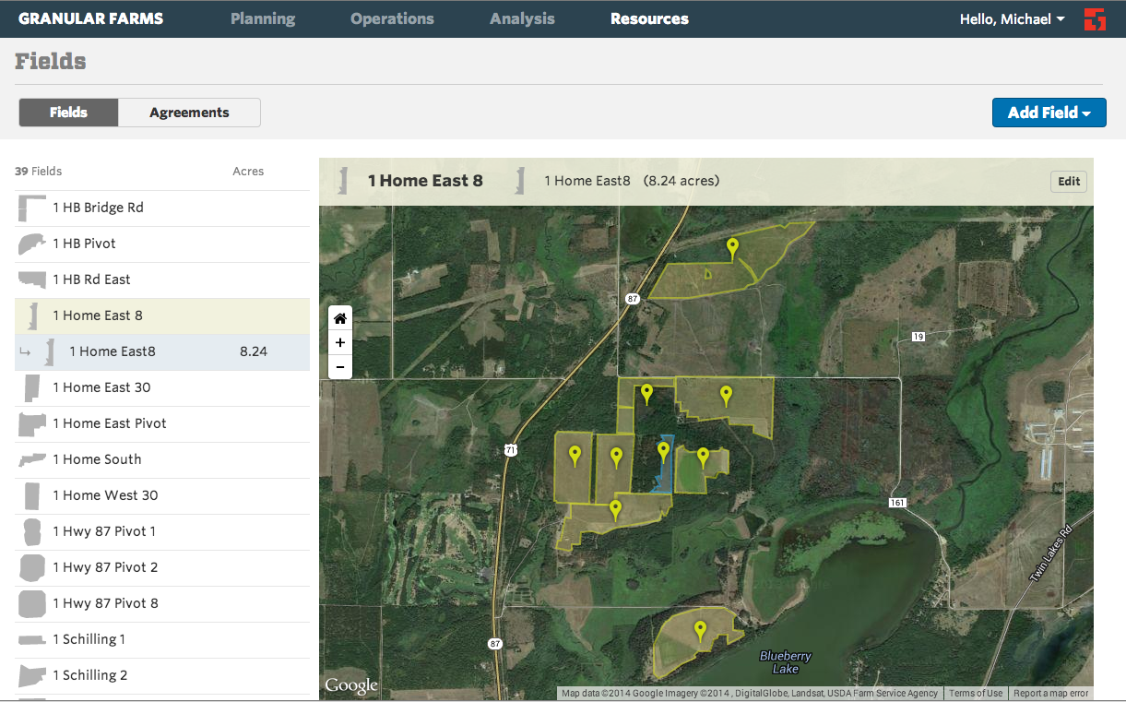
Our product:

Slide 122
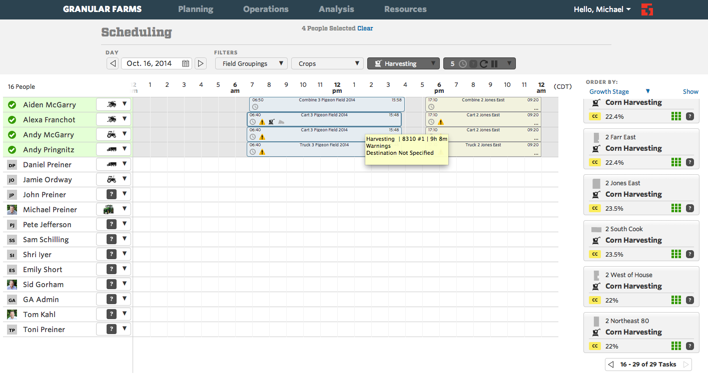
Our product:

Slide 123
Our product:

Slide 124
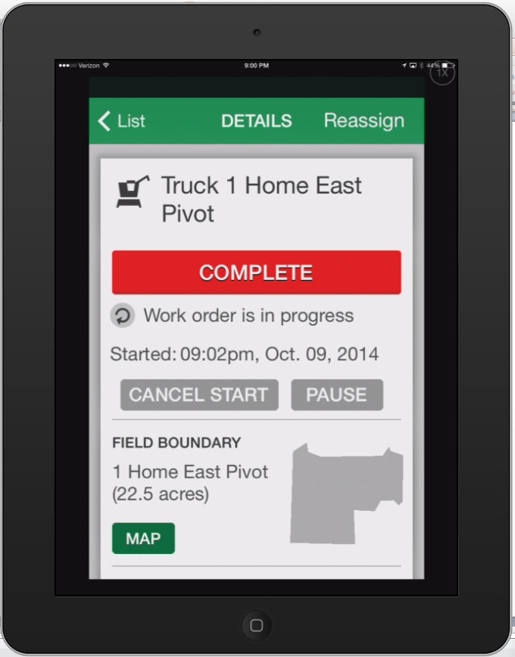
Our product:

Slide 125
References
Product Management
Marty Cagan: Inspired: How to Create Products Customers Love
Silicon Valley Product Group (SVPG)
Design
Donald Norman
Allan Cooper
Engineering
http://www.agilealliance.org/

Slide 126
Announcements
Assignment 4 was due Monday 10/20 11:59PM
Unit Economics
Assignment 5 - Financial Metrics
Due via msande273@gmail.com to the TAs by Monday 10/27 11:59pm
Optional Reading: Presenting the Plan and Negotiating the Deal, Technology Ventures, Chap. 19, p. 423-435.
Raising Initial Funding For High Technology Companies in the San Francisco Bay Area, Greguras and Stafford, Fenwick & West LLP.
East Coast vs. West Coast: Regional Differences in Venture Capital Financing, Cooley Godward, LLP, Aug 2007.
Speaker Prep: Ann Muira-Ko
Speaker Prep: Scott Sandell

